Slide 1

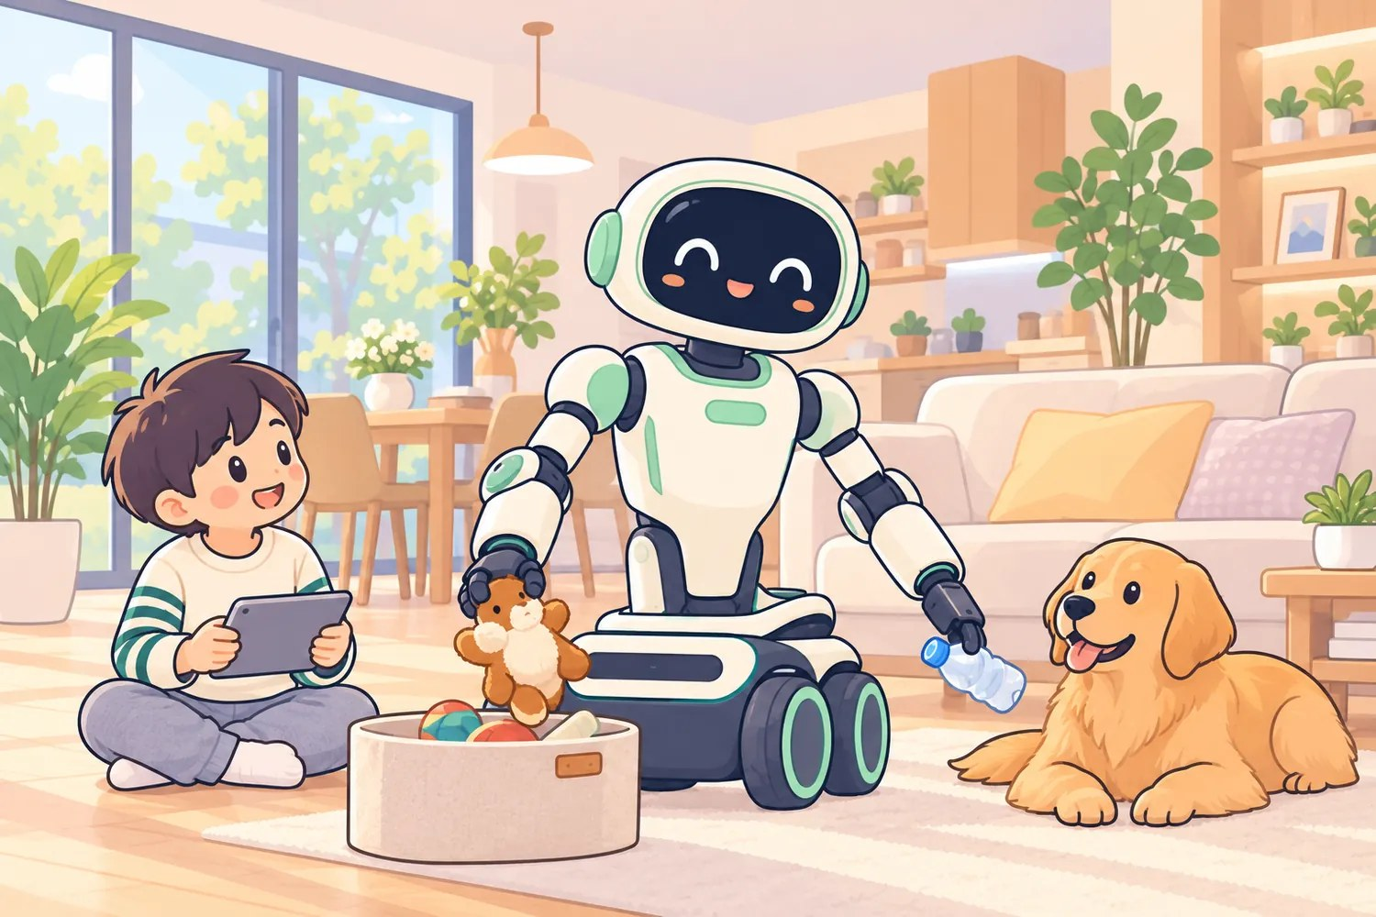
Physical AI
for the Home
OriginX AI
BP v7.3 · 2026.09
ORIGINX AI · BUSINESS PLAN V7.3
An intelligent growth companion: world-model driven, self-improving (RSI) from the very first real unit
For the happiness of every family
The family is where we start and where we land; every piece of our software and hardware is designed around it
Home scene · Q1 with a child
World model × low-cost body × household real-robot data × RSI auto experiments
Seed round · raising ¥100M
Raising ¥100M · 15% equity
Flagship robot on the market in 6 months
15% equity · about ¥670M post-money · September 2026 · Founder Qinzhen Ma · Simulation Evaluation & World Model Research Leader, Lightwheel
A1 ¥100-class · Z1 ¥3,000-class · Q1 under ¥20,000
Core edge: the RSI platform
Confidential · for invited investors and industry partners only.
Notes:
OriginX · Physical AI for the Home · Business Plan v7.3
https://brightfuture.originxairobotics.com/en/

Slide 2

Meet OriginX in one video
▶ · INTRO VIDEO
Chinese narration · 1 min 21 s
Click the video to play it during the slideshow
Watch online
brightfuture.originxairobotics.com/en/

Slide 3
Investment summary
01 · INVESTMENT SUMMARY
Oppor-
tunity
Position: an intelligent growth companion; we build the scarce layer: bodies in homes plus the real-robot data loop
Seed round · raising ¥100M · 15% equity · about ¥670M post-money
This ¥100M round is phase 1: one thing in 6 months, the flagship robot on the market; the first feature the RSI platform iterates is inference speed
High-
lights
Founder: Head of Hardware & Simulation (Shanghai) and World Model Research Leader at Lightwheel; has built the whole embodied-AI chain
Core competitive edge: our own RSI platform (recursive self-improvement), software and hardware in one loop, iterating and optimizing every robot feature automatically
Home education: a controllable, paid, reproducible first scenario
The world model evaluates, real-robot data corrects; prototypes already live, R&D speed is the moat
Expected
returns
12 months: 20,000 units shipped, hardware revenue ≥ ¥60M, 500K real-robot episodes, into phase 2 with a ¥500M raise
24 months: into phase 3, a general-purpose home robot and a household data network in place, target Series A
For the happiness of every family: an affordable robot in the home, real-robot data flowing back, and an RSI platform that keeps making it better.

Slide 4
Why we started
Capabilities commoditize, real-robot data stays scarce
02 · WHY NOW, WHY US
The view
The timing
The plan
Simulation and general models will standardize and get cheap. What stays scarce is a body living in real homes and the real-robot data loop that corrects the world model. That is the gap I saw at Lightwheel.
Simulation and synthetic data are mature; open-source bodies are mature, so a ¥3,000-class robot is buildable; using a world model as a VLA corrector is work I did at Lightwheel. All three line up now.
Add the body and the real-robot data loop, tie them together with the world model, and turn it into an RSI platform — that is our core edge. Start with home education, ship in 6 months, no slideware robots.
What I built at Lightwheel
Simulation & synthetic data
Exists · Lightwheel does it well
OriginX fills both gaps
World model
brain
World model: VLA corrector & ranker
Simulation evaluation stack
Real-robot deployment optimization
Data collection
Home robot body
Missing · no body inside real homes
Low-cost body
Real-robot data
Real-robot data loop
Missing · no real failures flowing back
Head of Hardware & Simulation · World Model Research Leader
Every link of the chain, by hand
Loop starts in home education
The two gaps: the body gives the world model somewhere to land; real-robot data lets the real world correct it.
Simulation gives coverage; only real robots give the truth. Closing that loop is possible now.
Notes:
What I did at Lightwheel: Head of Hardware & Simulation (Shanghai) and World Model Research Leader. The world-model track (turning the world model into a universal corrector for VLA policies: forward-predict candidate actions, score and rank them, correct before execution), the simulation evaluation stack, real-robot deployment optimization, and data collection. I have built every link of the chain by hand and know where each one breaks.
Simulation and synthetic data: the industry already has strong supply here, and Lightwheel is a leading example. Simulation gives coverage, hard cases and cheap scale, but it cannot give the real world’s long tail or ground truth.
A home robot body (missing): without an affordable, child-safe body of our own running inside real homes, a world model has nowhere to land.
A real-robot data loop (missing): without failures and parent corrections flowing back from real homes, the world model’s prediction residual is never corrected, and it stays inside simulation.
OriginX fills both gaps: a low-cost body plus a household real-robot data loop, tied together by the world model. We start with home education, a controllable scenario families pay for, so robots generate real data at home every day.

Slide 5




Four people, four lanes
Technology / commercialization / marketing & fundraising / safety
03 · TEAM
Qinzhen Ma
Gerald Xu
Mingwei Sun
Shichen Tang
Founder / CEO · Technology
Partner · Marketing & fundraising
Co-founder · Commercialization
Co-founder · Safety gate
linkedin.com/in/qinzhen-ma ↗
linkedin.com/in/gerald-xu ↗
linkedin.com/in/shichent ↗
Lightwheel · Head of Hardware & Simulation (Shanghai) · World Model Research Leader, reporting to founder Chen Xie
Rice Kavraki Lab / RobotΠ Lab · NASA intern (US) · ex-Baidu senior algorithm engineer
Cornell MEng, Electrical & Computer Engineering · admitted to Fudan via competition · Silicon Valley full-stack engineer; 20 years of coding, 10 software copyrights, 4 patents
Employee #2 at Jingya Capital, investing in AI and SaaS; backed unicorns eSign and Zilliz
Co-founder of Vland: tens of millions of RMB from Sequoia and Shunwei, 150 mid-to-large customers, a 30-person R&D team
Took an overseas companion robot from 0 to 1 through engineering and sales: CES 7,000+ sign-ups, nearly 1,000 pre-orders; backed by Li Zexiang’s incubation network
12 years in cloud computing and AI industrialization
Supply chain, fundraising, go-to-market
PhD Mathematics, UC Irvine · MS Computer Science, Rice
Optimization, planning, control · sim-to-real consistency evaluation
Owns pre-execution safety gate · real-robot reliability acceptance · release sign-off · child-safety certification
Owns supply chain & production · channels & sales · compliance
Owns RSI platform · world model · body · data collection
Owns brand & marketing · fundraising & investor relations
Advisors Ruihai Wu · UC Berkeley postdoc · robot manipulation ｜ Gaotian Wang · Rice PhD student · author of the XLeRobot open-source platform
Technology makes the robot smart, commercialization gets it sold, marketing and fundraising take it further, safety gates every release.

Slide 6
Pain points and fixes
It moves, improves, is affordable, and learns from data
04 · PAIN POINTS & SOLUTION
Pain point
What we do
01
Talks, can’t act
A body that really moves; kids teach it with a 30–120 s demonstration or phone teleoperation
02
Shelved after 3 weeks
RSI self-improvement: new skills every month by OTA, better the more it is used
03
Expensive / unsafe
A1 at ¥100-class, Z1 at ¥3,000-class, Q1 under ¥20,000; low speed, light payload, hard stops, task whitelist
04
No household data
Professional data factory + household real-robot loop; parental consent, rewards only for data that enters training
The root cause is a missing real-robot data loop. We put robots in real homes so they generate real data every day and get stronger because of it.

Slide 7
World model
Imagine first, then act, corrected by real outcomes
05 · WORLD MODEL
Observation
vision · state · instruction
VLA policy
proposes K candidate actions
World model
forward-predicts each candidate
imagine, don’t trial-and-error
Score · rank · correct
success · safety · preference
Training feedback
world model + VLA updated
Predicted vs real
residual = correction signal
Real outcome
success / failure / parent correction
Real-robot execution
best action after the safety gate
Role 1 · Corrector
Ranks and corrects actions before execution
Role 2 · Evaluator
Filters models offline before any real run
Role 3 · Data engine
Counterfactual generation from real-robot data
The world model is the evaluation and correction engine of the RSI platform: corrector · evaluator · data engine.
Without a world model
Every candidate runs on a real robot
World model screens first · target
−80% real-robot validation runs
A world model is worth exactly as much real-robot data as has corrected it.
Notes:
Observation: head RGB-D, wrist cameras, joint state, and voice / text instructions, encoded once and fed to both the policy and the world model.
VLA policy: a vision-language-action model that proposes K candidate action sequences for the current observation. It proposes; it does not anticipate.
World model: for each candidate it forward-predicts the next several steps of observation and state, i.e. imagine first, then act. This is the track I led at Lightwheel and the evaluation engine of our RSI platform.
Score, rank, correct: candidates are scored on predicted success probability, safety constraints and parent preferences; the best one is selected and corrected. Dangerous actions are stopped here.
Real-robot execution: the best action passes the safety gate (speed, force, workspace, whitelist) and runs on the body.
Real outcome: success, failure, or a parent takeover / correction, labelled automatically on device.
Prediction vs reality: the residual between what the world model predicted and what actually happened is the most valuable signal in the loop: it tells the model where the real world differs from its imagination.
Training feedback: residuals and real data update the world model and the VLA together; a more accurate world model makes ranking and correction more effective.
Role 1 · Corrector: ranks and corrects candidate actions before execution, blocking dangerous actions and making the policy more reliable on real robots.
Role 2 · Evaluator: offline regression evaluation with the world model filters out models and skills that are not worth a real-robot run.
Role 3 · Data engine: counterfactual generation starting from real-robot data extends the long tail; real outcomes correct the world model in return, which is what makes generated data trustworthy.

Slide 8
Three growth companions
A ¥100-class A1 to get in the door, a ¥3,000-class Z1 for volume, Q1 under ¥20,000 for manipulation
06 · PRODUCTS
Design before features: the product must look designed, and every piece of software and hardware is built to grow up alongside a child. A companion, not a pile of features.
Desktop · first unit at home
Experiment model · volume
Full model · manipulation
¥100-class
¥3,000-class
Under ¥20,000
A1
Z1
Wheeled dual-arm robot · Q1
A ¥100-class desktop companion. It talks, sees and shows expressions — no manipulation — so a family can own its first robot at the lowest possible threshold.
A small bipedal duck for the desk. It walks, sees and shows expressions; kids run balance and gait experiments and teach it motions.
Moves and manipulates with two arms. Gen-1 skills: conversation · desk tidying · Gomoku.
Form
Desk-ornament size; expression screen + camera + mic array
Form
Bipedal duck; head camera + opening beak
Form
Omnidirectional wheeled base + dual arms + head RGB-D camera
Role
Entry and volume: the cheapest way into the home, and into the data loop
DoF
14 (5 per leg × 2 + 4 neck / head)
DoF
6 per arm × 2 + gripper × 2; 3 base
Status
Planned; shares the world model and curriculum with Z1 / Q1
Progress
RL training pipeline (PPO) and robot console connected
Safety
≤ 500 g per arm · ≤ 0.5 m/s · stop on collision
Price
¥100-class (target)
Price
¥3,000-class
Price
Under ¥20,000

Slide 9
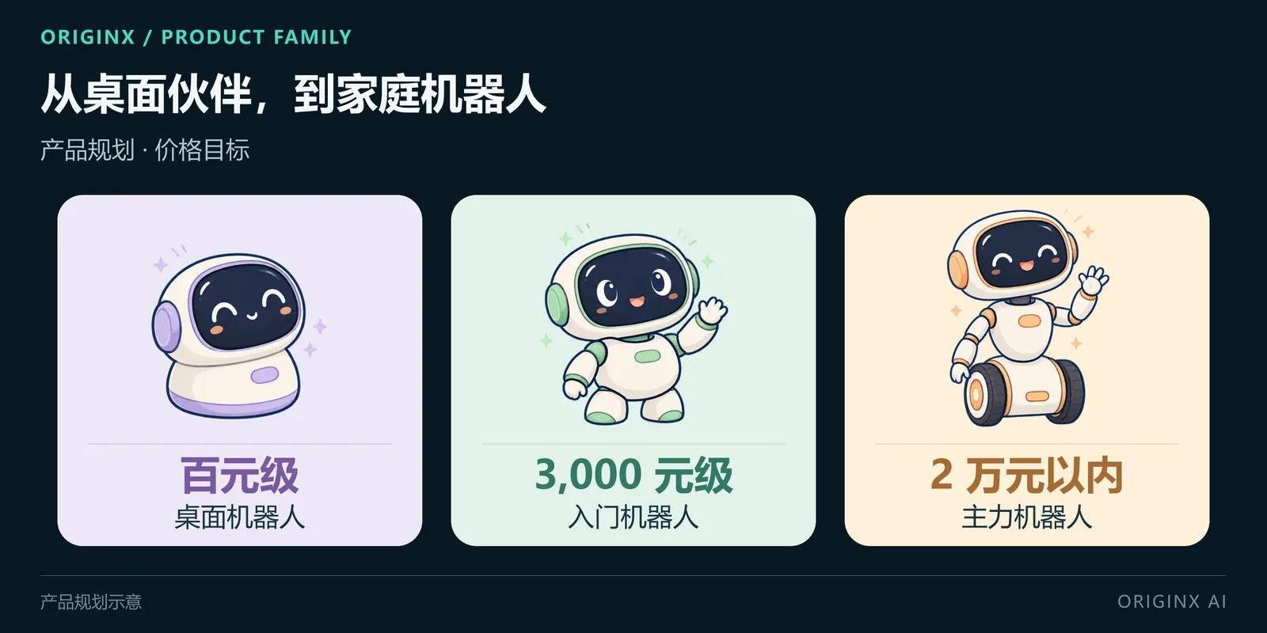
Products
One brain, three bodies
06 · PRODUCTS
B
World model
In-house
corrector · evaluator · data engine, shared by all three
S
Skills
In-house core
gait · motion imitation · teleoperation · lessons; iterated automatically by the RSI platform, monthly OTA
H
Hardware
Open-source + ours
built on mature open-source platforms; industrial design, child safety and production engineering are ours
Product plan · from desktop companion to home robot (all prices are targets)
A third robot is already in internal tests: a general-purpose home-scenario robot, trialled in home scenes built into our office. It is phase 3.
A ¥100-class A1 to get in the door, a ¥3,000-class Z1 in every home, Q1 under ¥20,000 for real manipulation; all three get stronger every month.

Slide 10
The RSI platform
Software and hardware in one self-improving loop
07 · RSI
RSI — recursive self-improvement: train → evaluate → real-robot regression → release → real-robot data back → train again, the whole chain already wired together, with people setting only the goal and the safety limits; within 6 months the first feature, inference speed, iterates fully automatically, while the rest is still launched by hand. This is our core edge.
Software × hardware
Core edge
Working prototypes
Live
Compounding
Faster each round
One platform drives both the model pipeline and the robot itself: teleoperation, capture, real-robot regression and monthly OTA all sit inside the loop. Simulation alone, or hardware alone, cannot close it.
The interactive operation platform (teleop · capture · inference) and the SuperAgent five-agent experiment loop are live and wired to Z1 RL.
Every round adds data and skills; cycle time is the compounding rate. In 6 months, inference speed iterates fully automatically.
Goals & safety
human
Task & data
auto
Training
auto
World-model eval
auto
Real-robot regression
auto
Approval & OTA
human
Real-robot data flows back → next round
Inside one RSI round: amber is human, everything else is automatic

Slide 11
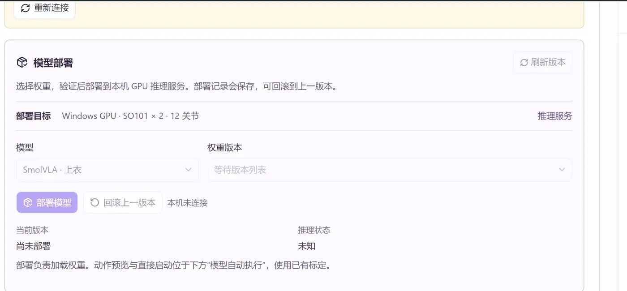
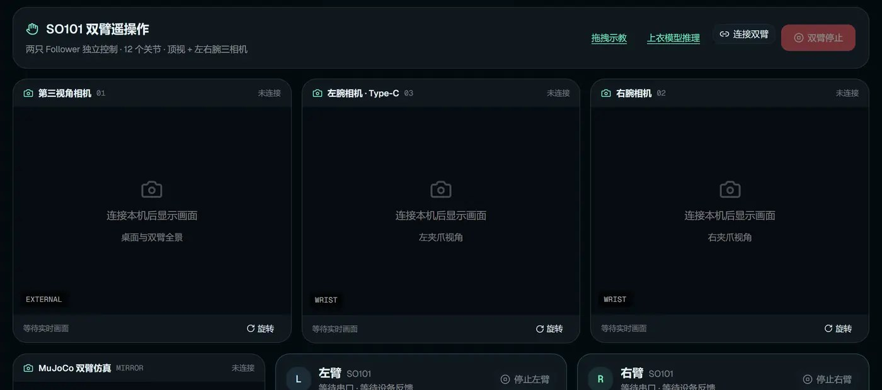
The RSI platform
Self-evolution · world-model loop
07 · RSI
Use at home
1 feature
2,000+
1/mo
1
inference speed on full auto (6-month target)
auto experiments / week (12-month target)
OTA cadence
More homes
6
Self-evolution
world-model loop
2
Data flows back
Monthly OTA
5
3
Model correction
4
SuperAgent · model deployment and rollback (prototype live)
Interactive operation platform · dual-arm teleoperation and capture (live)
Auto experiments
RSI compresses train–evaluate–real robot–data into one loop that runs by itself: iteration speed is the moat, and it gets faster every round.
Notes:
1 · Use at home: Kids and parents use the robot daily in lessons, imitation and teleoperation, so it runs inside real homes every day.
2 · Data flows back: Successes, failures, parent corrections and preferences return after parental consent and on-device de-identification.
3 · Model correction: Prediction residuals update the world model and the VLA; a more accurate world model makes correction and evaluation stronger.
4 · Auto experiments: Task generation, data selection, training, offline evaluation and real-robot regression run automatically, producing candidate releases every week; evaluation gaps become the next collection orders.
5 · Monthly OTA: Skills and models that pass the safety gate are pushed to robots at home every month, so the robot gets better the more it is used.
6 · More homes: Better robots bring word of mouth and trade-ins; a new hardware generation every six months, trained on the previous generation’s data.

Slide 12
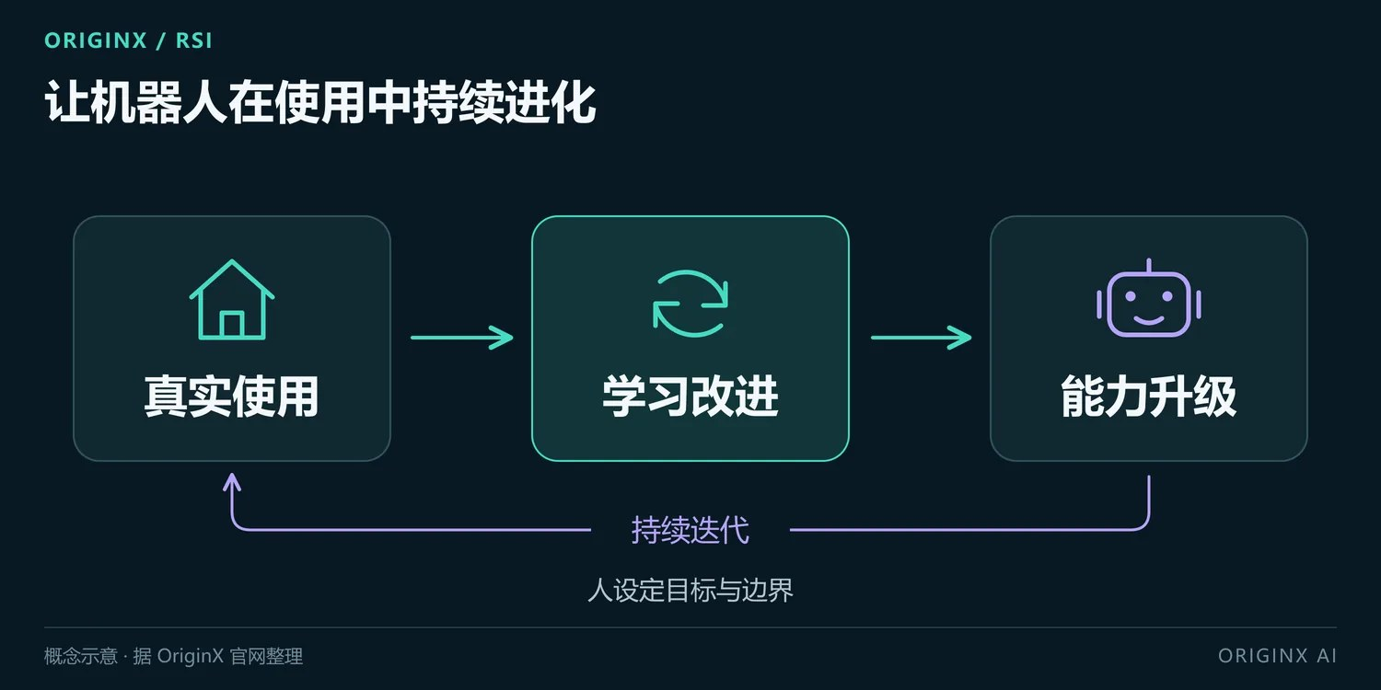
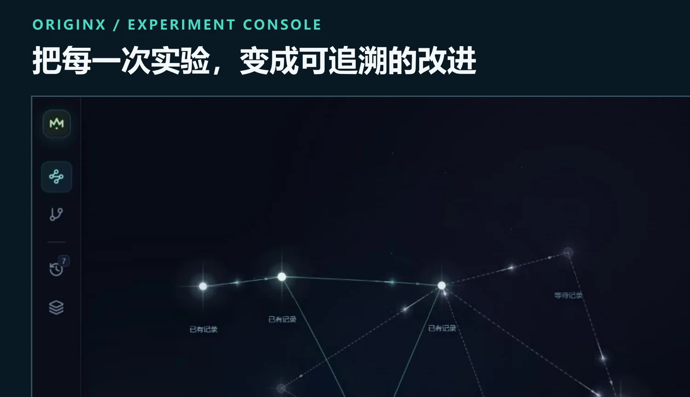
Real-robot data loop
Data factory + household network
08 · REAL-ROBOT DATA LOOP
Concept · people set the goal and the limits, RSI does the rest
Professional data factory
gold standard
20 standardized stations, 2,000+ labeled episodes a day (success / failure / takeover)
The RSI platform decides what to collect: world-model evaluation and real-robot regression find weak spots → collection orders generated automatically
Experiment console · every run becomes a traceable improvement
Household network
real long tail
A natural entry point: lessons run every day, so kids’ demonstrations and parents’ corrections come from normal use
Only in homes: parental consent · on-device de-identification · rewards only for data that enters training
The factory gives standards and scale; homes give the long tail and the truth. Whoever is in the home holds the data.

Slide 13
Roadmap
Three phases, from the flagship robot to a general-purpose home robot
09 · ROADMAP
Phase | Robot | RSI platform | Skills | Real-robot data | Homes
Now 2026-09 | Z1 prototype · robot console live; third robot in internal tests in office-area home scenes | SuperAgent prototype: 5-agent loop | — | — | —
Phase 1 Months 0–6 · this ¥100M round | Flagship robot launched, first 1,000 units | First feature on full auto: inference speed | 20 | 50K | First customers
Phase 2 Months 7–18 · ¥500M raise | ~1.2 m robot with more built-in skills; 20,000 flagship units shipped | Platform mature, covering every skill | 300 total | 3M | 50,000
Phase 3 Months 19–24 | General-purpose home-scenario robot | Automatic cross-body transfer · fully automatic release candidates | 1,000 total | 10M | 100,000

Slide 14
Roadmap
Real-robot data and cumulative skills (targets)
09 · ROADMAP
Three phases, one RSI platform: the more mature the platform, the more skills carry over to new robots, all the way to a general-purpose home robot.

Slide 15
Business model
Hardware gets in the home, content and trade-ins keep it there
10 · BUSINESS MODEL
213M
157M
~20M units
children aged 0–14 in China
students in compulsory education in China
consumer service robots sold worldwide in 2024, mostly floor cleaners
Sources: China NBS and Ministry of Education 2025 bulletins; IFR World Robotics 2025
① Hardware first
② Subscription & trade-in
③ Platform & data
Three bodies
Staying in the home
Worth more with use
A1 to get in the door, Z1 for volume, Q1 for manipulation; ≥ ¥60M hardware revenue in 12 months.
Courses, experiment kits, learning reports; a new generation every six months, upgrade for the difference.
Institutional edition · SDK; every unit at home keeps feeding the RSI platform.
Hardware gets the robot into the home, content and trade-ins keep it there, and every unit that stays keeps feeding the RSI platform.

Slide 16
Benchmarks
Sunday (US) and 未来不远 (China)
11 · BENCHMARK
Both are betting on the same thing: home robots are won by how fast real-household data comes back. The difference is how that loop runs.
S
Sunday Robotics
F
未来不远 Futuring Robot
Gloves first, robot second
Rent first, sell later
Product: Memo, wheeled dual-arm, explicitly not a bipedal humanoid; ≈USD 20,000 to hand-build (company-stated), no retail price ever published
Route: collect data first with a Skill Capture glove built to match its gripper (2,000+ shipped, 500+ paid collectors), then build the robot; the ACT-1 model is claimed to be trained with zero robot data (company-stated)
Delivery: not purchasable as of 2026-09, a free 50-household invite beta; its funding release says first homes within 2026, its own FAQ states at-scale shipping in 2027–2028
Product: F1 (2025-09, ~80 kg, 22 DoF); F2 (2026-04, from ¥36,000, no delivery date published)
Route: ¥3,000 a month, roughly one month per household before rotating on — get the robot into homes first, sell later
Tech & manufacturing: self-evolving WAM predicts risk, AVLA executes, failures recycle into training; full-stack in-house, 16 hardware generations, unit cost ¥20,000–30,000 (company-stated)
Funding
≈USD 200M cumulative, USD 1.15B post-money (2026-03)
Funding
Three rounds in six months, reported cumulatively as ≈¥1B or more (ZhenFund led the angel, Boyu Capital the second; no lead disclosed for the Pre-A, ByteDance among participants)

Slide 17
Benchmarks
Side by side
11 · BENCHMARK
Dimension | Sunday (US) | 未来不远 (CN) | OriginX AI
Scenario & form | Household chores; wheeled dual-arm, explicitly not bipedal | All-scenario home; wheeled dual-arm | Q1 wheeled dual-arm + Z1 desktop bipedal
Product & price | Memo; no retail price, ≈USD 20,000 to hand-build | F1 / F2; F2 from ¥36,000, ¥3,000 a month to rent | A1 ¥100-class; Z1 ¥3,000-class; Q1 under ¥20,000 (all targets)
Delivery | Not on sale; free 50-home invite beta; at-scale stated 2027–2028 | Already rented into homes; no F2 delivery date | Prototype; flagship to market in 6 months (target)
Route | Gloves collect the data first, the robot comes second | Rent first, sell later: get the robot into the home first | Make the body cheap first, then let the RSI platform make it strong
Data source | External glove capture (2,000+) plus paid collectors | Own robots in rented homes | Capture factory + real-robot regression + world-model evaluation feedback; home data once units ship
Iteration loop | Glove data into training data; cadence not published | World-model prediction plus failure recycling; cadence not published | RSI platform as one loop: train → evaluate → regression → release → data back (prototype running, not yet at scale)
In-house & manufacturing | Robot and glove in-house; manufacturing and capacity not published | Full-stack in-house (motors, joints, torque sensors); 16 hardware generations (company-stated) | Robot and RSI platform in-house; China supply chain
Their figures come from public reporting and company statements, as of 2026-09; neither publishes a release cadence or says whether real-robot regression is automated. On our side, prices, launch timing and the 20,000 units are targets, not delivered facts; our RSI loop is wired end to end, with inference speed the first function to run fully automatically.
Same bet on real-household data: Sunday gathered data before building the robot, 未来不远 rented robots into homes first. Our bet is on the speed of the loop itself — the RSI platform strings training, evaluation, real-robot regression, release and data return into one automated pipeline.

Slide 18
Financing
¥100M, one thing in 6 months
12 · FINANCING
This round
Use of funds (this ¥100M round · phase 1)
Deliverables by phase
¥100M
Flagship robot R&D, production & launch
50% ¥50M
Phase 1 · this ¥100M round: flagship robot on the market in 6 months, first 1,000 units; inference speed iterated fully automatically
✓
raise
RSI platform (first feature: inference speed)
30% ¥30M
✓
Phase 2 · ¥500M raise: RSI platform mature, more skills built into a ~1.2 m robot; 20,000 units shipped in 12 months
15%
¥670M
Marketing & first customers
10% ¥10M
equity
post-money (approx.)
✓
Phase 3: a general-purpose home-scenario robot
Core edge: the RSI platform
Operations, compliance & reserve
10% ¥10M
First scenario: home education
Total ¥100M (= 50 + 30 + 10 + 10)
Qinzhen Ma · Founder / CEO · qm18@rice.edu · linkedin.com/in/qinzhen-ma
For the happiness of every family: first a robot that works in the home, then an RSI platform that keeps making it better by itself.

Slide 19
For the happiness of every family
An affordable robot in the home, real-robot data flowing back, and an RSI platform that keeps making it better.
FOUNDER WECHAT
BUSINESS CONTACT
EMAIL · LINKEDIN
Qinzhen Ma · Founder / CEO
Zack · Business partner
qm18@rice.edu
luckyqinzhen
+86 136 5812 6513
linkedin.com/in/qinzhen-ma
Online version: brightfuture.originxairobotics.com/en/
OriginX AI · For the happiness of every family · Business plan v7.3 · September 2026 · Confidential, private share only.

